Slide 1

Sweet Home
Assessment Basics
August, 2019

Slide 2
Four Essential Questions
What do we want students to know and be able to do?
How will we know if students have learned it?
What will we do if students haven’t learned it?
What will we do if students already know it?
2
3
4
Professional Learning Communities

Slide 3
What Do We Want Students to Know and Be Able to Do?
What do we want students to know and be able to do?
The adopted state standards define what we want students to know.
We’ve identified district priority (power) standards.
National Standards
State of Oregon
Standards
Sweet Home Power
Standards

Slide 4
How Will We Know if Students Have Learned It?
How will we know if students have learned it?
State Assessments measure student mastery of the state’s standards
State of Oregon Standards

Slide 5
How Will We Know if Students Have Learned It?
How will we know if students have learned it?
Local Assessments
  Formative Assessments
  Common Formative Assessments
  Interim Assessments
  Summative Assessments
National or State Standards
Sweet Home Priority Standards

Slide 6
Assessment Types: For and Of Learning
Formative Assessment: (FOR Learning)
A process used by teachers and students during instruction that provides feedback to teachers and students to inform ongoing teaching and learning to improve students’ achievement of intended instructional outcomes.
Summative Assessment: (OF Learning)
Evaluates learning at the end of an instructional period by comparing against a standard benchmark.
Notes:
In order to address the first target of our learning, we need to differentiate between formative and summative assessments.
(click return) and have participants read the first definition
(click return) and have participants read the second definition
In partners, discuss the key differences.

Slide 7
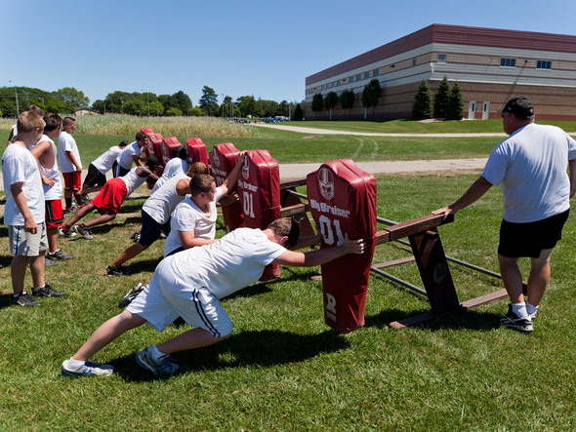
Assessment FOR Learning

Slide 8
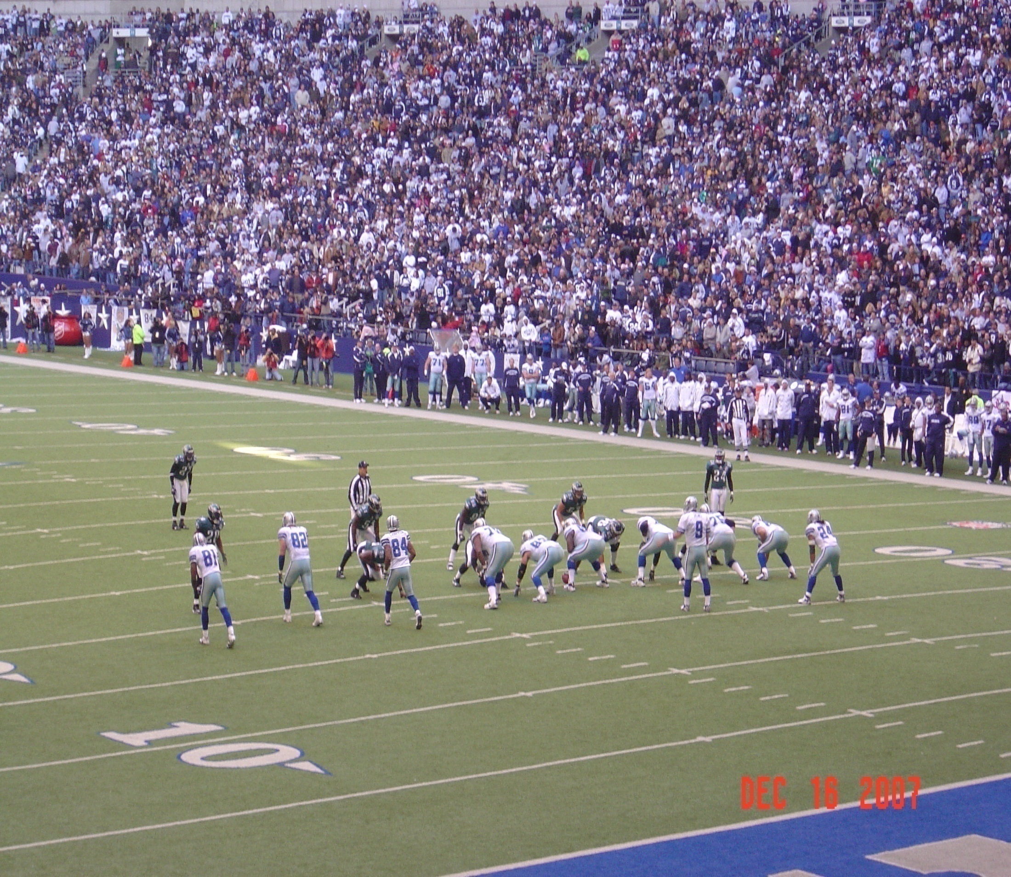
Assessment OF Learning
Notes:
The BIG game
In our terms this is the summative assessment. This is the assessment OF learning.
Examples of assessment OF learning:
•Summative assessment for unit, quarter, semester, grade level, or course of study
•Provides a “status report” on degree of student proficiency or mastery relative to targeted standards.

Slide 9
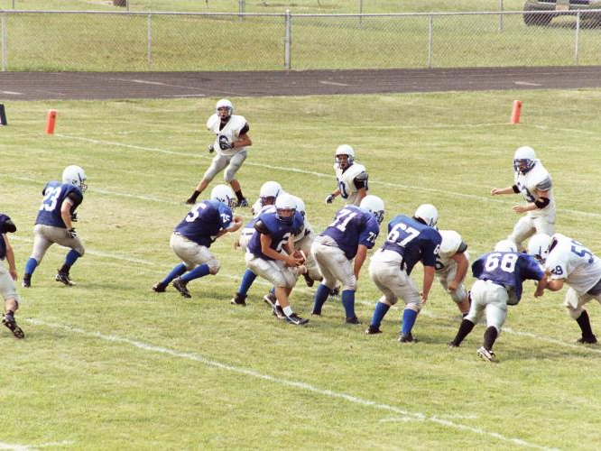
Interim Assessments

Slide 10

Formative Assessments
What is it? A process of questioning, testing or demonstration used to identify how a student is learning, where his strengths and weaknesses lie, and the potential strategies to improve that learning. It focuses on individual growth.
Who is being measured? Individual students. The way they answer gives insight into their learning process and how to support it.
How Often? Ongoing: Often as part of a cycle of instruction and feedback over time. Results are immediate or very rapid.
For what purpose? To diagnose problems in students’ understanding or gaps in skills, and to help teachers decide next steps in instruction.
What strategies are used? Written or oral test questions, observation protocols designed to identify problems areas or misconceptions in learning.

Slide 11
Interim Assessments
What is it? interim assessment is a comparison of student understanding or performance against a set of uniform standards within the same school year. It may contain hybrid elements of formative and summative assessments, or a summative test of a smaller section of content, like a unit or semester.
Who is being measured? Individual students or classes.
How Often? Intermittent: Often at the end of a quarter or semester, or a midpoint of a curricular unit. Results are generally received in enough time to affect instruction in the same school year.
For what purpose? To help educators or administrators track students’ academic trajectory toward long-term goals. Depending on the timing of assessment feedback, this may be used more to inform instruction or to evaluate the quality of the learning environment.
What strategies are used? Often a condensed form of an annual summative assessment, e.g. a shorter term paper or test. It may be developed by the teacher or school, bought commercially, or be part of a larger state assessment system.

Slide 12
Summative Assessment
What is it? Summative assessment is a comparison of the performance of a student or group of students against a set of uniform standards
Who is being measured? The educational environment
How Often? Point in time: Often at the end of a curricular unit or course, or annually at the same time each school year.
For what purpose? To give an overall description of student’s status and evaluate the effectiveness of the educational environment.
What strategies are used? Summative assessments are standardized to make comparisons among students, classes, or schools.

Slide 14
District Assessment Calendar

Slide 15
Current District System of Assessment
 | Formative | Interim | Summative
State |  |  | Kindergarten Assessment Smarter Balanced (3-8,11) OSAS Science (5,8,HS) ELPA (K-12 ELL)
District |  | SBAC Interim Blocks DIBELS (K-5)
School/Teacher | Checks for Understanding Cold Calls White Boards Exit Tickets Etc… Quizzes CFAs developed by PLCs | Unit Tests Classroom Tests Mid-Terms | Finals

