Slide 1
Professional Learning Communities, Part I
Shared Understanding
(Adapted from Professional Learning Communities at Work
Designed by DuFour, DuFour and Eaker)

Slide 2
Confirming Common Understanding
    Big Ideas
    Continued shifts in beliefs and practices

Slide 3
What does PLC mean?
“An on going- process in which educators work collaboratively in recurring cycles of collective inquiry and action research to achieve better results for the students they serve.”
        -DuFour, DuFour, Eaker and Many (2010)
Notes:
Many times the term PLC is used to describe work done in schools, but it is much more than just meeting as a group.
PLC is not a workshop, program, book study, or meeting.

Slide 4
What Does the Research Say About This Model?
The research suggests that in order for significant and sustained school improvement to occur, these key factors must be in place:
  Efforts must focus on data.
  Collaborative effort with staff ownership.
  Staff must be given time.
  Active learning by staff.
  Supported by administration/district.

Slide 5
PLC Big Ideas
1. Ensure That Students Learn
      Learning for All
2. Collaborate
      Teamwork
3. Focus on Results
      Data-Driven Decisions
Notes:
When talking as group about what is important from the PLC conference the three big ideas stuck out most.

Slide 6
Big Idea #1
Ensure That Students Learn
    “The fundamental purpose of the school is to ensure that all students learn rather than see to it that all students are taught-an enormous distinction.”
    -Raising the Bar and Closing the Gap-Whatever it Takes
    We accept learning as the fundamental purpose of our school and therefore are willing to examine all practices in light of their impact on learning.
Notes:
The focus in not if the curriculum was taught, but if it was learned.

Slide 7
Big Idea #1
Critical Questions of Learning
What is it that we expect students to learn?
How will we know when they have learned it?
How will we respond when they don’t learn?
How will we respond when they already know it?
Notes:
Common Curriculum- This will be discussed later also as it relates to formative assessment.
Common Assessment
Common Pacing
The ideal shift here with these critical questions would be to get teachers to the point that when things aren’t going well they look in the mirror to say what can I change? We want to move past the excuses of that is how he/she is or a blame on parents.
Once teachers see these questions they may feel scripted or the need to teach identically to their neighbor. This however is not the case, the beginning is the same (focusing on the big ideas) the end is the same (formative assessment) it is the middle where the teacher gets to show their art of teaching.

Slide 8
Big Idea #1
Ensure That Students Learn
  Essentials
  Implementing
  Monitoring
  Responding

Slide 9
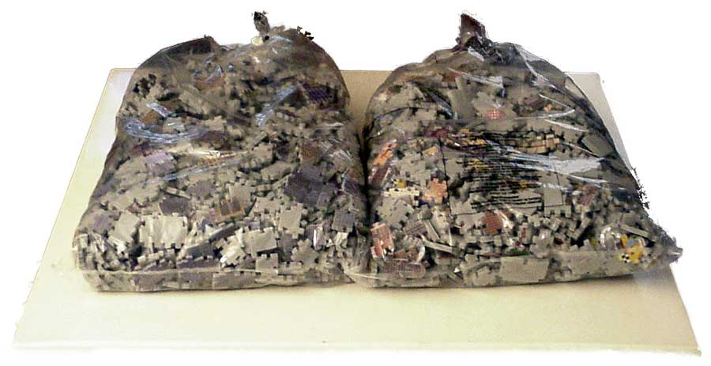
Big Idea #1
Ensure That Students Learn—Essentials
Clear, understandable targets are posted.
Instruction addresses the target.
Assessments address the target.
Students receive feedback.
Repeat as often as needed

Slide 10
Big Idea #1
Ensure That Students Learn—Implementing
  Targets are displayed, defined and revisited.
Students are engaged.
Students are having conversations and writing about their learning.
“Lecture is the best way to get information from the teacher’s notebook
to the student’s notebook without touching the student’s mind.”
-George Leonard

Slide 11
Big Idea #1
Ensure That Students Learn—Monitoring
Students know the learning target and understand
that an assessment will give them information
relative to the target.
Students receive frequent feedback.
Notes:
Monitor the expectations by attending the meetings and reviewing the meeting notes, and particularly note what follow-through occurs and is addressed at the next meeting. Working in teams can be chaotic and challenging at times, so monitoring is very important. Teams need to be assured that they can spend additional time on essential content students haven’t mastered if more than one source shows there is a weakness shared by most of the class and if a different and engaging strategy will be used to reteach the content. This is a case where it would be appropriate to deviate from the standards map for a short time. This is why they are considered maps and not a pacing guide.

Slide 12
Big Idea #1
Ensure That Students Learn—Responding
Interventions and extensions are based on the data.
  These may include flexible grouping and differentiated tasks.
Notes:
Monitor the expectations by attending the meetings and reviewing the meeting notes, and particularly note what follow-through occurs and is addressed at the next meeting. Working in teams can be chaotic and challenging at times, so monitoring is very important. Teams need to be assured that they can spend additional time on essential content students haven’t mastered if more than one source shows there is a weakness shared by most of the class and if a different and engaging strategy will be used to reteach the content. This is a case where it would be appropriate to deviate from the standards map for a short time. This is why they are considered maps and not a pacing guide.

Slide 13
Big Idea #2
Collaborate
    We are committed to working together to achieve our collective purpose.
    We cultivate a collaborative culture through development of high-performing teams.
    “A systematic process in which we work together, interdependently, to analyze and impact professional practice in order to improve our individual and collective results.”
    -DuFour, Dufour & Eaker

Slide 14
Big Idea #2
Collaborate
Why?
Gains in student achievement
Higher quality solutions to problems
Increased confidence among all staff
Teachers able to support one another’s strengths and accommodate areas for growth
Ability to test new ideas
More support for new teachers
Expanded pool of ideas, materials, and methods
        Judith Warren Little (1990)
Notes:
When teachers are collaborating, egos need to be left at the door.

Slide 15
Big Idea #2
Seven Keys to Collaboration in a PLC
Embed collaboration in routine practices of the school.
Schedule time for collaboration in the school day and school calendar.
Focus teams on critical questions.
Make products of collaboration explicit.
Establish team norms to guide collaboration.
Pursue specific and measurable team performance goals.
Provide teams with frequent access to relevant information.
Notes:
3 and 4: Hand out Critical Issues for Team Consideration questionnaire
Example Timeline for products:
By the end of the
2nd week: Team Norms
4th Week: Team SMART Goal
6th Week: Common essential outcomes
8th Week: First common assessment
10th week: Analysis of student performance on first common formative assessment: This is a great time to sit in and listen to the group discussion and ask them what they need from you.

Slide 16
Big Idea #3
Focus on Results
    We assess our effectiveness on the basis of results rather than intentions.
    Individuals, teams, and schools seek relevant data and information and use that information to promote continuous improvement.
Notes:
Share Meaningful teamwork, results oriented goals, regular collection and analysis of performance data.
This is where the team also develops its SMART goal.
We liked the quote that without data, your just another person with an opinion.

Slide 17
Culture Shifts in a PLC
Traditional Focus
Every student can learn
Focus on teaching
Isolation
Assessment OF learning (Summative)
Failure is an option
PLC Focus
Every student will learn
Focus on learning
Collaboration
Assessment FOR learning (Formative)
Failure is not and option
Notes:
A summary
Cedar Rapids Power Point

Slide 18
Professional Learning communities, Part II
Shared Practice

Slide 19
Establishing Common Practices
    Determine Who Participates
    Identify Essential Components of PLC Meetings
    Review the Collaborative Cycle
    Capturing PLC Conversation/Planning
    Know Your Resources

Slide 20
Building Background
Inefficient PLC Teams | Efficient PLC Teams

Slide 21
Who Should Participate?
    “Effective school cultures don’t simply encourage individuals to go off and do whatever they want, but rather establish clear parameters and priorities that enable individuals to work within established boundaries in a creative and autonomous way.”
    All Licensed Staff
    Loose vs. Tight
  Procedures are “tight”—Science of teaching
  Agreement on what is to be taught is “tight”—Science of teaching
  How content is taught is “loose”—Art of teaching

Slide 22
Essential Components of PLC Meetings
  Identify, maintain, and evaluate Team Norms and Roles
  Construct formative assessments aligned to standard/learning targets
  3. Evaluate student progress
  4. Celebrate successes
  5. Use protocols to move through the 3-Week Cycle

Slide 23
Breaking it Down:
Establishing, Maintaining, and Evaluating Team Norms and Roles
Why ?
What happens if/when a peer…..
  Shows up without data?
  Is frequently late or doesn’t attend?
  Doesn’t contribute equally to conversation?
  Appears consistently disinterested?
  Veers from a PLC focus?
  When all is said and done, the norms of a group help determine whether it functions as a high-performing team or becomes simply a loose collection of people working together.
Notes:
Adaptive Schools Handbook
NSDC-how to establish norms

Slide 24
Breaking it Down:
Construct Common Formative Assessments Aligned to Learning Targets
What is formative?
‘inform’ students, provide feedback and inform instruction
What is common?
Team agreement
What exactly is a CFA?
  Short and sweet, one or two learning targets

Slide 25

Breaking it Down:
Evaluate Student Progress
What skills did the proficient students demonstrate in their work that set their work apart?
What instructional strategies helped students learn?
In what areas did students struggle? Why? (Obstacles, Challenges, Misconceptions)

Slide 26
Breaking It Down
Celebrate Successes
Do not overlook, or underestimate, the importance of celebrating the successes in your work as a team!
“ Specific goals should be designed to allow teams to achieve small wins as they pursue their common purpose. Small wins are invaluable to building members’ commitment and overcoming the obstacles that get in the way of achieving a meaningful, long-term purpose.”
        (Katzenbach & Smith, 1993, p. 54)

Slide 27
Breaking it Down:
  Use Common Protocols to Move Through the 3-Week Cycle
    Meeting 1, Standard, Targets, designing a CFA
    Meeting 2, Analyzing data and responding to student needs
      What do we do with the students who have not learned the target?
    Meeting 3, New target, designing a CFA
    Meeting 4, Return to steps identified in Meeting 2

Slide 28
How to PLC, Version 1.0

Slide 29
So What?
“The visual doesn’t tell me anything about what meetings should look like. What happens during a PLC meeting?”
How to PLC, Version 2.0

Slide 30
Now What?

Slide 31
Acknowledgement
Thank you to the following teachers who gave their feedback and developed these protocols!
Emma Brock
Katelynn Duggan
Megan Gonyea
Peter Larson
Rachel Markell
Debbie Rehart
Delise Rose
Brittanie Sorensen
Jerika Spencer
Daniel Young

Slide 32
PLC Meeting Cycle
Typically a 3-meeting process
  Your team may take longer.
  Your team may work more quickly.

Slide 33
Using Protocol Forms to Move Through the 3-Week Cycle
  PLC Protocol Form 1 and Protocol Form 2
  -Fill out during each meeting
    -Share with administrator after each meeting
  * Digital copies are on the Teaching and Learning Webpage
  * Protocol forms may be emailed or printed for your Supervisor
  * The PLC team should retain a copy

Slide 40
Singletons
1. Common Models
  Cross discipline
  Vertical
2. Common skills and outcomes, not grade level/content power
standards
3. Venues
  TwitterforSingletons
  Google Hangout
  Reach out to other districts

Slide 41
Checking for Understanding
Turn to a partner: Can you identify the 5 components of a PLC meeting?
  Identify, maintain, and evaluate Team Norms and Roles
  Construct formative assessments aligned to learning targets
  3. Evaluate student progress
  4. Celebrate successes
  5. Use protocols to move through the 3-Week Cycle

Slide 42
What will this look like at name of school?
2019-2020 professional development calendar
Most Wednesday afternoons…
(at least 27 Wednesdays)
add other options here

Slide 43
Application: Agenda Items That Begin Today
Item 1: Establish (or Evaluate) Team Norms
  Please develop/reconfirm team norms
Item 2: Fill in as appropriate to your site
Item 3: Fill in as appropriate to your site

Slide 44
Reminder: Change is Messy!
We can tell we are making progress if ….
Every staff member participates and contributes.
We analyze and reflect upon our teaching.
We implement and assess changes.
We have honest conversations with each other that help us engage in the process.

Slide 45
How Should We Determine what is the right work?
The Best available evidence of positive impact on student learning

Slide 46
Key Dates and Actions
September 4th clarify what your site will do
September 11^{th,} Agreement on Overarching Power Standards
September 18th, PLC Meeting 1, Form 1

Slide 47
Resources
National Training, PLC at Work Institute
District PLC Handbook
Technical Assistance for Singleton Planning
Teaching and Learning Website
  Forms
  Links to AllthingsPLC
  Professional Reading
School Improvement Teacher Leaders
PLC Cadre representatives
Administrators

