Slide 1

RTI At Work Institute
3-2-1
  3 Aha’s/learnings
  2 ideas that you’re school will be implementing this year
  1 Way this will impact you work this year
District RTI Updates
  Meeting to look at draft SST handbook/forms week after next
  SST (Intervention Team) meetings
    Weekly
    7 week rotations for each grade

Slide 2
ACEs/PBIS Continued
August 9, 2018

Slide 3
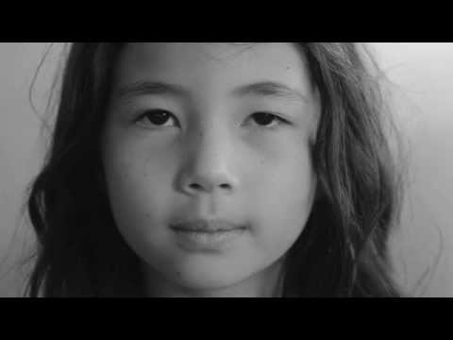
Just Breathe

Slide 4
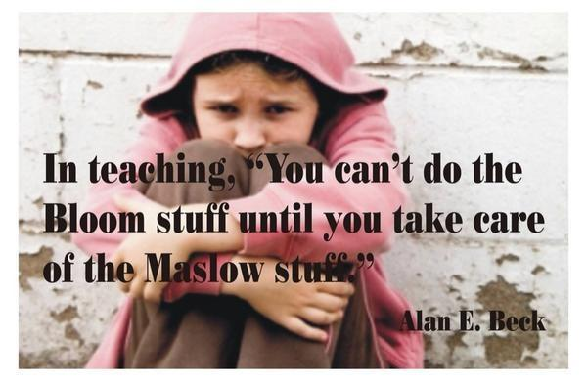

Slide 5
Objectives For This Session
Briefly review ACEs/trauma information
Learn more about effective, trauma-informed practices
Learn about resources that are available to you and your staff

Slide 6

Part I
A Quick Review

Slide 7
Using a “Trauma Lens”
A shift in perspective…
From “What is wrong with this student?”
To “What has this student been through?”

Slide 8
What is an ACE Score?
An ACE score is a tally of different types of abuse, neglect, and other hallmarks of a rough childhood.
According to the Adverse Childhood Experiences study, the rougher your childhood, the higher your score is likely to be and the higher your risk for later health problems.

Slide 9
Fight, Flight & Freeze; What do These Look Like in
Children?
  FIGHT
    Hyperactivity, verbal aggression, oppositional behavior, limit testing, physical aggression, “bouncing off the walls”
  FLIGHT
    Withdrawal, escaping, running away, self-isolation, avoidance
  FREEZE
    Stilling, watchfulness, looking dazed, daydreaming, forgetfulness, shutting down emotionally

Slide 10
Fight, Flight & Freeze; What do These Look Like in
Children?
Look for moments when the intensity of the child’s response does not match the intensity of the stressor
Or when a child’s behaviors seem inexplicable or confusing. Consider—might the student’s alarm system have gone off?
Remember: the primary function of the triggered response is to help the child achieve safety in the face of perceived danger.

Slide 11
What Might You Notice About Students?
Reactivity and impulsivity
Aggression and defiance
Withdrawal/avoidance
Perfectionism
Repetitive thoughts or comments about death or dying
Non-age appropriate behavior
Anxiety/worry about safety of self and others
Poor or changed school performance and attendance
Overly protective of personal space or belongings

Slide 12
What Might You Notice About Students?
Difficulty with…
  Organization
  Cause and effect
  Taking another’s perspective
  Attentiveness
  Regulating emotions
  Engaging in the curriculum
  Transitions

Slide 13
Common Triggers for Traumatized Children
Unpredictability or sudden change
Transition from one setting/activity to another
Loss of control
Feelings of vulnerability or rejection
Confrontation, authority, or limit setting
Loneliness
Sensory overload (too much stimulation from the environment)

Slide 14
Positive Behavior and Intervention Supports
If a student doesn’t know how to read, we
If a student doesn’t know how to swim, we
If a student doesn’t know how to multiply, we
If a student doesn’t know how to behave, we
teach.
teach.
teach.
punish.

Slide 15
“Never discipline a kid for something the adults have failed to explicitly teach.”
-Mike Mattos

Slide 16
4 Components of PBIS
PBIS
Positive Behavior Intervention and Support
Tiered Behavioral Instruction and Intervention
Proactive, Preventative, Efficient
Establish
Expectations
All Areas
All Staff and Students
Explicitly Teach
Expectations
All Areas
All Staff and Students
Reinforce
Expectations
All Areas
All Staff and Students
Correct
Behavioral Errors
All Areas
All Staff and Students

Slide 17

Part II, How Can We Respond Effectively?
Give Staff the information and resources they need to respond effectively to every student.

Slide 18

Trauma & School Performance
Students who have experienced trauma:
  Are two-and-one-half times more likely to fail a grade
  Score lower on standardized achievement test scores
  Have more receptive or expressive language difficulties
  Are suspended or expelled more often
  Are designated to special education more frequently.
  Center for Disease Control and Prevention, 2009
Notes:
18

Slide 19
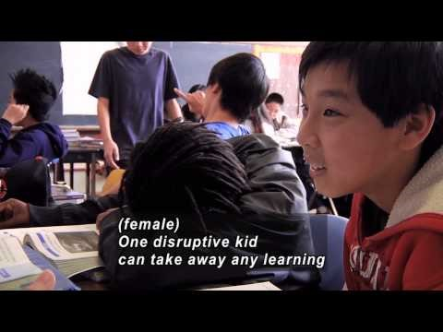
Room to Breathe

Slide 20
“Many teachers and principals think kids’ bad behavior is deliberate, and that the kids can control it. But it’s often not and they can’t—not without help.”
“You can’t punish behavior out of a kid……The old school model of discipline expects kids to listen to you just because you’re a grown-up.”
“No amount of star charts, reasoning with or demanding explanations from or yelling at the terrified horse will make a difference.”

Slide 21

Shift from "What's wrong with you?" TO "What happened to you?"
Notes:
So often we hear the question or experience internal dialogue of what’s wrong with you? Why are you acting like that? Why won’t you/Why can’t you just?
A Responsive School or Responsive teacher who is trauma informed changes their perspective and understanding from “what’s wrong with you to what happened to you?
We may not always know what has happened to our students but the idea is we realize “children do well if they can” ..so we equip ourselves with a compassionate approach and utilize an approach to support all students in our classrooms.

Slide 22

10 Things Every Teacher Should Know about Childhood Trauma
Kids who have experienced trauma aren’t trying to push your buttons
Kids who have been through trauma worry about what’s going to happen next
Even if the situation doesn’t seem that bad to you, it’s how the child feels that matters
Trauma isn’t always associated with violence
You don’t need to know exactly what’s caused the trauma to be able to help
Kids who experience trauma need to feel they’re good at something and can influence the world
There’s a direct connection between stress and learning
Self-regulation can be a major challenge for students suffering from trauma
It’s okay to ask kids point-blank what you can do to help them make it through the day
You can support kids with trauma even when they’re outside your classroom
cc: T.Kiya - https://www.flickr.com/photos/38217580@N05
Notes:
10 Things Every Teacher Should Know about Childhood Trauma

Slide 23
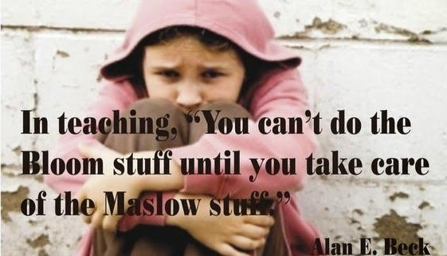
The Essentials
Understand Trauma
Promote Safety
Compassionate Communication
Empower Students
Build Relationships
Develop a School Plan

Slide 24
Strategies to Establish Safety
Clear /consistent rules for managing behavior/setting limits
  Least Invasive Strategies
Accommodations to meet individual strengths and needs:
  Transition and Safety Plans
  Calm Zones
Predictable structure, relationships, and environment to promote safe surroundings and interpersonal relationships
  Class meetings
  Daily Schedule
  Environment Check
Reduce bullying and harassment
Notes:
Establishing safety is a key component of a responsive classroom.
This first point ties into both establishing safety and building trust. The student does not want to feel as though they are on a stage when their behavior is not ideal and we don’t want to give them that stage, so utilizing least invasive strategies is an example of a clear consistent approach to managing your classroom.
We are thinking ahead of what could possibly be triggers for students and setting them up for success by helping them feel as though they are in a secure and safe environment.
Students may be lacking this structure at home so providing them with the opportunity to build meaningful relationships and connect with others allows them to send signals to their brain that this is safe environment which then encourages an environment to learn

Slide 25
A Note About Sensory Areas
With the sensory room, and the help of adults, students are now learning how to identify the sensations of their bodies that let them know they are triggered and need an intervention to prevent escalation. They give their teacher a signal, or the teacher gives them one, with understanding and compassion, not judgment or shame. Off they go to get the help they need to get their school brain back from survival mode. When they get their school brain back from being stuck in fight or flight, it becomes possible for them to come back to class and learn more of what their teacher is trying to teach.

Slide 26
Compassionate Communication
Empathy: (Ex: How sad… I bet that hurts…)
Send the power message: (What do you think you are going to
do?)
Offer choices: (Would you like to hear what other kids have
tried?)
Have the child state the plan and consequences: (Ask: How do you
think that will work?)
Give permission for the child to either solve the problem or not.
If they choose not to, tell them you will solve it for them
(however, emphasize it was their choice not to)

Slide 27
Empower Students Through Love and Logic
Rule #1:
Adults set firm limits in loving ways
without anger, lecture or threats.
Rule #2:
When a child causes a problem, the
adult hands it back in loving ways.
Here’s how it’s done….
1. Shared control
2. Shared thinking and decision-making
3. Equal shares of consequences with empathy
4. Maintain the child’s self-concept
The Love & Logic Institute http://www.loveandlogic.com/

Slide 28

Ideas for Building Relationships
Meet and greet at the door/Shake their hands
Student survey of interests
Anagram nametags
Acknowledge students by name
Personal notes on assignments
Student of the week
Classroom morning meetings
Weekly questions about you
Weekly ice breakers

Slide 29

Developing a Trauma Sensitive/Responsive School
Support and teach children who have experienced trauma
Teach social and emotional skills
    MindUP Curriculum
Teach and practice self regulation skills
Focus on the strong link between academic success and social-emotional skills
Practice self regulation skills daily, such as mindful breathing or movement.
Approach is "What happened to you?" not "What's wrong with you?"

Slide 30
School-Based Strategies & Interventions
Tier 1 –
Universal Strategies
Tier 2 – Selective
Classroom Strategies
Tier 2 & Tier 3 Targeted Counseling Strategies
Morning meetings
Mindfulness Moment – same time every day
Yoga, meditation, 3-6 breathing, imagery
Heart breathing
Mindfulness Bottles
Community drumming
Reduced Stimuli
Music
Rhythmic activities
Parent Ed.
Growth Mindsets, Positive Discipline, Sensory experiences, Mindfulness
Classroom Guidance using
Mind Up or other social-emotional curriculum
Collaborative Problem-
Solving
3-6 breathing
Calming Zone
Sensory interventions
visual, auditory, touch, movement, taste, and smell
Time Out bottles
Drawing
Further reduce stimuli
Individual counseling
Narrative approaches
  Play, art, music-based
  Drumming/Rhythmic activities
  Sensory Interventions
  Heart Breathing
Support groups (art-based)
Animal Assisted Intervention
Co-facilitate Multimodality Trauma Treatment (MMTT) with trained Licensed Counselor
Community Referrals
30
Notes:
30

Slide 31

Tools and Strategies
Calming bottles
Drumming
Breathing ball
Stability balls
Sensory tools
Meditation/Guided Imagery
Yoga
Animal Assisted Therapy
cc: Nick Kenrick. - https://www.flickr.com/photos/33363480@N05

Slide 32

cc: ForbesOste - https://www.flickr.com/photos/71035640@N08

Slide 33

“Mindfulness means paying attention in a particular way; On purpose,
in the present moment, and
non-judgmentally.”
- Jon Kabat-Zinn
cc: lewishamdreamer - https://www.flickr.com/photos/26503210@N00
Notes:
Mindful eating exercise

Slide 34
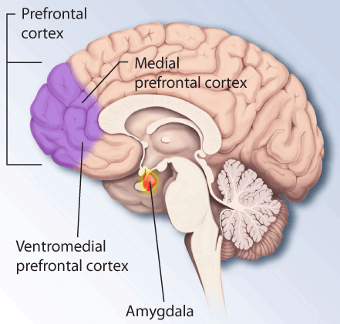
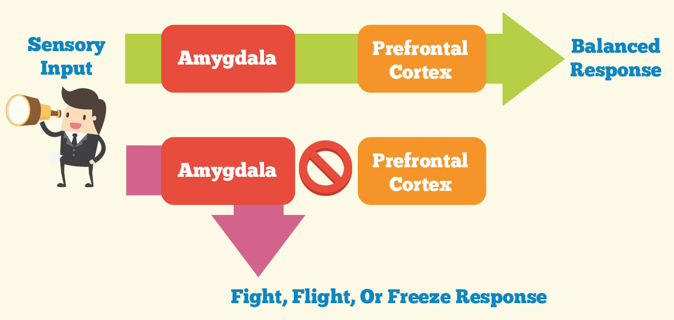
MindUP Curriculum
Notes:
Show MindUP Posters
Talk about upstairs brain and downstairs brain poster

Slide 35


Slide 36
Responsive Teacher Behaviors
Creates and/or maintains consistent daily routines for the classroom.
Tells children when something out of the ordinary is going to occur.
Offers children developmentally appropriate choices.
Anticipates difficult periods and transitions and offers extra support during these times.
Uses techniques to support children’s self-regulation.
Helps students manage their feelings during intense emotional moments by remaining composed and offering empathy and support.
Is appropriately nurturing and affectionate.
Uses positive guidance and supportive interventions to help all children
Goals for achievement of students affected by traumatic experiences are consistent with the rest of the class.
Notes:
1. Creates and/or maintains consistent daily routines for the classroom. (Students know the order of the day or events and how they will be carried out. There is a schedule for the day or calendar of events visible to the students. Expectations are communicated in clear, concise, and positive ways.)
2. Tells children when something out of the ordinary is going to occur. (Activities are structured in predictable and emotionally safe ways. Teacher warns children about bell, fire drill, special assembly, visit from an outsider, etc.)
3. Offers children developmentally appropriate choices. (Students’ strengths and interests are encouraged and incorporated. Students have ownership of their behaviors and interests. Students are allowed to choose options or activities, such as where they want to sit or do for certain activities.)
4. Anticipates difficult periods and transitions and offers extra support during these times. (Teacher sits by student, walks with student, etc.)
5. Uses techniques to support children’s self-regulation. (Teacher introduces breathing and other centering activities, such as mindfulness, during and outside of school-wide mindfulness activities to help children self-regulate. Opportunities exist for students to learn and practice regulation of emotions and modulation of behaviors.)
6. Helps students manage their feelings during intense emotional moments by remaining composed and offering empathy and support. (Opportunities exist for learning how to interact effectively with others. Teacher calmly initiates healthy and reparative interactions, validates student’s feelings and communicates that s/he understands that the student is upset, explains to the student that s/he needs to keep his body safe, and slowly moves between student and what or who s/he is acting out toward. (This shows that the teacher understands that children make sense of their experiences (negative and positive) by reenacting them in play or through interactions with peers or adults).)
7. Is appropriately nurturing and affectionate. (Teacher is sensitive to children’s individual triggers, physically affectionate only when student seeks it.
8. Uses positive guidance and supportive interventions to help all children. (Teacher guides children to appropriate activities, helps children understand their action and how it impacts others.)
9. Goals for achievement of students affected by traumatic experiences are consistent with the rest of the class. (Information is presented and learning is assessed using multiple modes. Opportunities for all students exist for learning how to plan and follow through on assignments.)
36

Slide 37
Trauma Training Facilitator’s Toolkit
http://ciscentraltexas.org/wp-content/uploads/2017/06/Trauma-Training-Toolkit-8-29-2016.pdf

Slide 38
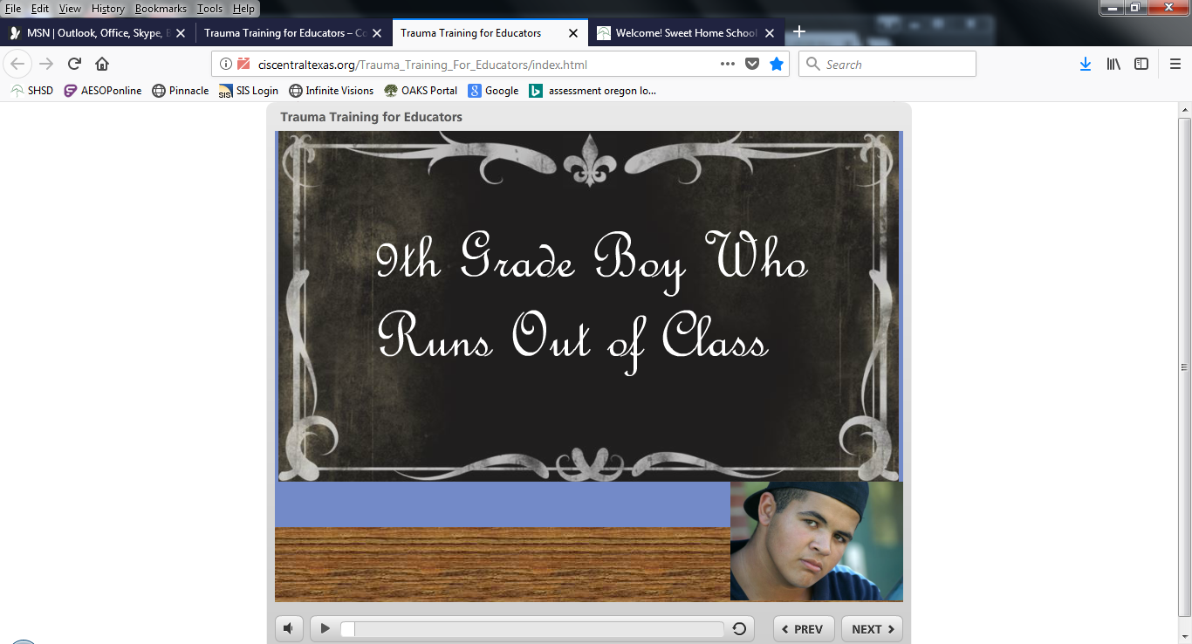
Important Notice: The Trauma Training for Educators video works best on Mozilla Firefox. You may encounter problems with Google, Internet Explorer, etc. If the direct link does not work properly – Copy and paste the URL address below into your Firefox browser, rather than just clicking on the link. The link may not bring up both the audio and visual portions of the video.
http://ciscentraltexas.org/Trauma_Training_For_Educators/index.htm

Slide 39
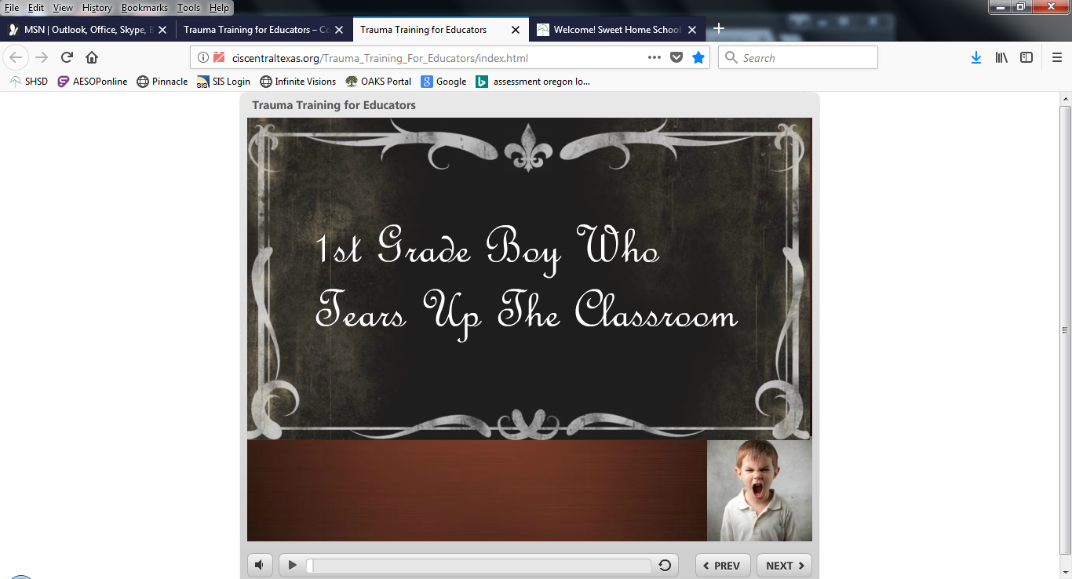

Slide 40
Childhood Trauma Toolkit
https://wmich.edu/sites/default/files/attachments/u57/2013/child-trauma-toolkit.pdf

Slide 41

Where’s the Science Behind This?

Slide 42
How to Support Staff
Provide training for your staff
Let staff know what you believe
Require ‘sensory corners’ in every classroom
Establish a school sensory room
Evaluate PBIS staff perceptions and system effectiveness
Explore the culture of Mindfulness as a staff
Ongoing PD/book study

Slide 43
Training Resources for Inservice Week
ACES power points and related activities
Child Trauma Toolkit
Pages 12-36 of the Facilitators toolkit
Videos
  Trauma Training ‘moving’ power point
  Ted Talk with Nadine Burke Harris
  Just Breathe, trailer and movie
  Room to Breathe, movie
  Paper Tigers, movie

Slide 44

PBIS Systems
PBIS Fall Checklist
PBIS Self Assessment Survey (SAS)
School-wide Evaluation Tool (SET)

Slide 45

Inservice Week
What are your ideas for sharing the following with staff?
  ACEs
  Trauma-Informed Practices
  PBIS

Slide 46
Who are you as a disciplinarian?
How do you communicate this?
Design a very brief presentation for your staff on who you are as a disciplinarian. This can be a power point, a story, an article, etc.
Please be prepared to share your presentation with you’re the admin. team when we come back together on the 21st.

Slide 47

Professional Growth and Evaluation
Table of Contents
A Closer Look at Forms
Frontline Update

Slide 48
Preview of August 21st
Frontline
PLC Update
Strategic Monitoring Plans
Nuts and Bolts

