Slide 1
Positive School
Wide Systems
May 31, 2018

Slide 2
Our Focus
Adverse Childhood Experiences
Trauma-informed Schools
Positive Behavior and Intervention Support
Reflecting PBIS in communication to staff and parents

Slide 3
Considerations About Trauma
Trauma is prevalent in the lives of children.
Trauma affects learning and school performance, and causes physical and emotional distress.
Children/teens experience the same emotions as adults, but may not have the words to express them.
Trauma sensitive schools help children feel safe to learn.
Schools have an important role to play in meeting the social/emotional needs of students.

Slide 4
What Makes an Experience Traumatic?
Overwhelming, very painful, very scary
Fight or Flight incapacitated
Threat to physical or psychological safety
Loss of control
Unable to regulate emotions
Trauma is the response to the event, not the event itself.

Slide 5
Trauma’s Impact on Brain Development
Exposure to chronic, prolonged traumatic experiences has the potential to alter childrens’ brains, which may cause longer-term effects in areas such as:
  Attachment: Trouble with relationships, boundaries, empathy, and social isolation
  Physical Health: Impaired sensorimotor development, coordination problems, increased medical problems, and somatic symptoms
  Emotional Regulation: Difficulty identifying or labeling feelings and communicating needs
  Dissociation: Altered states of consciousness, amnesia, impaired memory
  Cognitive Ability: Problems with focus, learning, processing new information, language development, planning and orientation to time and space
  Self-Concept: Lack of consistent sense of self, body image issues, low self-esteem, shame and guilt
  Behavioral Control: Difficulty controlling impulses, oppositional behavior, aggression, disrupted sleep and eating patterns, trauma re-enactment
Source; Cook, A., Spinazzola, P., Ford, J., Lanktree, C., Blaustein, M., Cloitre, M., et al. (2005). Complex trauma in children and adolescents. Psychiatric Annals, 35(5), 390-398.

Slide 6
Physical Effects of Trauma on the Brain

Slide 7
Trauma’s Impact on Child Development
Trauma causes the brain to adapt in ways that contributed to their survival (i.e. constant fight/flight/freeze).
  ↓
  These adaptations can look like behavior problems in “normal” contexts, such as school.
  ↓
    When triggered, “feeling” brain dominates the “thinking” brain.
  ↓
  The normal developmental process is interrupted, and students may exhibit internalizing or externalizing behaviors.

Slide 8
Fight, Flight & Freeze; What do These Look Like in
Children?
  FIGHT
    Hyperactivity, verbal aggression, oppositional behavior, limit testing, physical aggression, “bouncing off the walls”
  FLIGHT
    Withdrawal, escaping, running away, self-isolation, avoidance
  FREEZE
    Stilling, watchfulness, looking dazed, daydreaming, forgetfulness, shutting down emotionally

Slide 9
Fight, Flight & Freeze; What do These Look Like in
Children?
Look for moments when the intensity of the child’s response does not match the intensity of the stressor
Or when a child’s behaviors seem inexplicable or confusing. Consider—might the student’s alarm system have gone off?
Remember: the primary function of the triggered response is to help the child achieve safety in the face of perceived danger.

Slide 10
Common Triggers for Traumatized Children
Unpredictability or sudden change
Transition from one setting/activity to another
Loss of control
Feelings of vulnerability or rejection
Confrontation, authority, or limit setting
Loneliness
Sensory overload (too much stimulation from the environment)

Slide 11
Adverse Childhood Experiences (ACE) Study
Collaboration between the CDC and Kaiser Permanente’s Health Appraisal Clinic in San Diego. Study took place between 1995 and 1997, CDC still tracking the medical status of the baseline participants.
  Retrospective approach examined the link between childhood stressors and adult health for over 17,000 adult participants. Each participant completed a questionnaire that asked for detailed information on their past history of abuse, neglect and family dysfunction as well as their current behaviors and health status.
  Designed to assess exposure to multiple types of stressors.

Slide 12
What is an ACE Score?
An ACE score is a tally of different types of abuse, neglect, and other hallmarks of a rough childhood.
According to the Adverse Childhood Experiences study, the rougher your childhood, the higher your score is likely to be and the higher your risk for later health problems.

Slide 13
The ACE Questionnaire
  Was a biological parent ever lost to you through divorce, abandonment, or other reason ?
  Did you live with anyone who was a problem drinker or alcoholic, or who used street drugs?
  Was a household member depressed or mentally ill, or did a household member attempt suicide?
  Did a household member go to prison?

Slide 14
ACE’s & Negative Well-Being

Slide 15
ACE and Risky Behaviors
The higher the ACE score, the more we see risky health behaviors in childhood and adolescence including:
Pregnancies
  Suicide attempts
  Early initiation of smoking
  Sexual activity
  Illicit drug use

Slide 16
Using a “Trauma Lens”
A shift in perspective…
From “What is wrong with this student?”
To “What has this student been through?”

Slide 17
What Might You Notice About Students?
Difficulty with…
  Organization
  Cause and effect
  Taking another’s perspective
  Attentiveness
  Regulating emotions
  Engaging in the curriculum
  Transitions

Slide 18
What Might You Notice About Students?
Reactivity and impulsivity
Aggression and defiance
Withdrawal/avoidance
Perfectionism
Repetitive thoughts or comments about death or dying
Non-age appropriate behavior
Anxiety/worry about safety of self and others
Poor or changed school performance and attendance
Overly protective of personal space or belongings

Slide 19
A Trauma-Informed School; Key Components
Establish a shared definition of a TIS
Enhance trauma awareness throughout the school community
  Conducting thorough assessment of school climate Inclusiveness
  Respect for Diversity
  Identifying Risk Factors
  Identifying Protective Factors
Develop trauma-informed discipline policies
Awareness of prevalence & impact of secondary traumatic stress on teachers and staff Wong, 2013

Slide 20
Resources
Trauma-Sensitive School Toolkit http://sspw.dpi.wi.gov/sspw_mhtrauma
Social-Emotional Learning Curricula http://www.casel.org/
School Mental Health Program Resources: California School-Based Health Alliance, www.schoolhealthcenters.org
Restorative Practices www.ocde.us/healthyminds//Pages/Restorative_Practices.aspx

Slide 21
The previous slides were developed and previously presented by:
Pamela Kahn, BS, RN
Coordinator, Health and Wellness
Lucy Vezzuto, Ph. D.
Student Mental Health, Social-Emotional Learning and School Climate
Orange County Department of Education

Slide 22
Why Learn About Childhood Trauma and ACEs?
A key component of a trauma-informed school is the………development of trauma-informed discipline policies.
We’re revisiting discipline policies today.

Slide 23
Positive Behavior and Intervention Supports
If a student doesn’t know how to read, we
If a student doesn’t know how to swim, we
If a student doesn’t know how to multiply, we
If a student doesn’t know how to behave, we
teach.
teach.
teach.
punish.

Slide 24
“Never discipline a kid for something the adults have failed to explicitly teach.”
-Mike Mattos

Slide 25
School-Wide Systems for Student Success:
Academic Systems
Behavioral Systems
Tier 3/Tertiary Interventions 1-5%
Individual students
Assessment-based
High intensity
1-5% Tier 3/Tertiary Interventions
        Individual students
        Assessment-based
        Intense, durable procedures
Tier 2/Secondary Interventions 5-15%
Some students (at-risk)
High efficiency
Rapid response
Small group interventions
Some individualizing
5-15% Tier 2/Secondary Interventions
        Some students (at-risk)
        High efficiency
        Rapid response
        Small group interventions
        Some individualizing
Tier 1/Universal Interventions 80-90%
All students
Preventive, proactive
80-90% Tier 1/Universal Interventions
        All settings, all students
        Preventive, proactive
Illinois PBIS Network, Revised May 15, 2008. Adapted from “What is school-wide PBS?” OSEP Technical Assistance Center on Positive Behavioral Interventions and Supports. Accessed at http://pbis.org/schoolwide.htm
Notes:
Judy Boggs and MW had the opportunity to present KYCID to the Commissioner’s Parent Advisory Council in April. At the end of the presentation. Comm H held up this slide and stated this is the answer for student success.
Levels of PBIS:
Tier 1/Universal Prevention – processes and procedures intended for all students and staff in all non-classroom settings
Classroom- processes and procedures that reflect school-wide expectations for student behavior coupled with pre-planned strategies applied within classrooms
Tier 2/Secondary Prevention - processes and procedures designed to address behavioral issues of students with similar behavior problems or behaviors that seem to occur for the same reasons (i.e. attention seeking, escape)
This is on schools readiness form
Tier 3/Tertiary Prevention – processes and procedures designed to meet the needs of students with the most serious academic/behavioral/emotional challenges
This is on schools readiness form

Slide 26
Why PBIS?
  Provides core teaching about important behaviors (Sugai & Horner, 2002)
  All students receive instruction
  Prevention is the goal
  Less students will need more intensive interventions (Gresham, 2005)
What does school-wide look like?
  Behavior is taught, practiced, and monitored across all school settings
  All students aware of expectations
  All adults model, monitor, and reinforce
  Should positively impact at least 80% of students
Notes:
If you have a video clip of a school to show, you might want to show it here.
Then say, “What are some typical outcomes schools experience as a result of implementing SW PBIS?”

Slide 27
School-Wide Practices
Instructional Lessons
Routines
Supervision
Reinforcement
Continuum of Consequences
Instructive “Consequences”

Slide 28
4 Components of PBIS
PBIS
Positive Behavior Intervention and Support
Tiered Behavioral Instruction and Intervention
Proactive, Preventative, Efficient
Establish
Expectations
All Areas
All Staff and Students
Explicitly Teach
Expectations
All Areas
All Staff and Students
Reinforce
Expectations
All Areas
All Staff and Students
Correct
Behavioral Errors
All Areas
All Staff and Students

Slide 29
Establish Expectations
All Areas
All Staff and Students

Slide 30
Establish Expectations
Define what is needed for students to be successful socially
Develop ‘looks’ and ‘sounds’ like matrix with all common non-classroom settings (well defined)

Slide 31
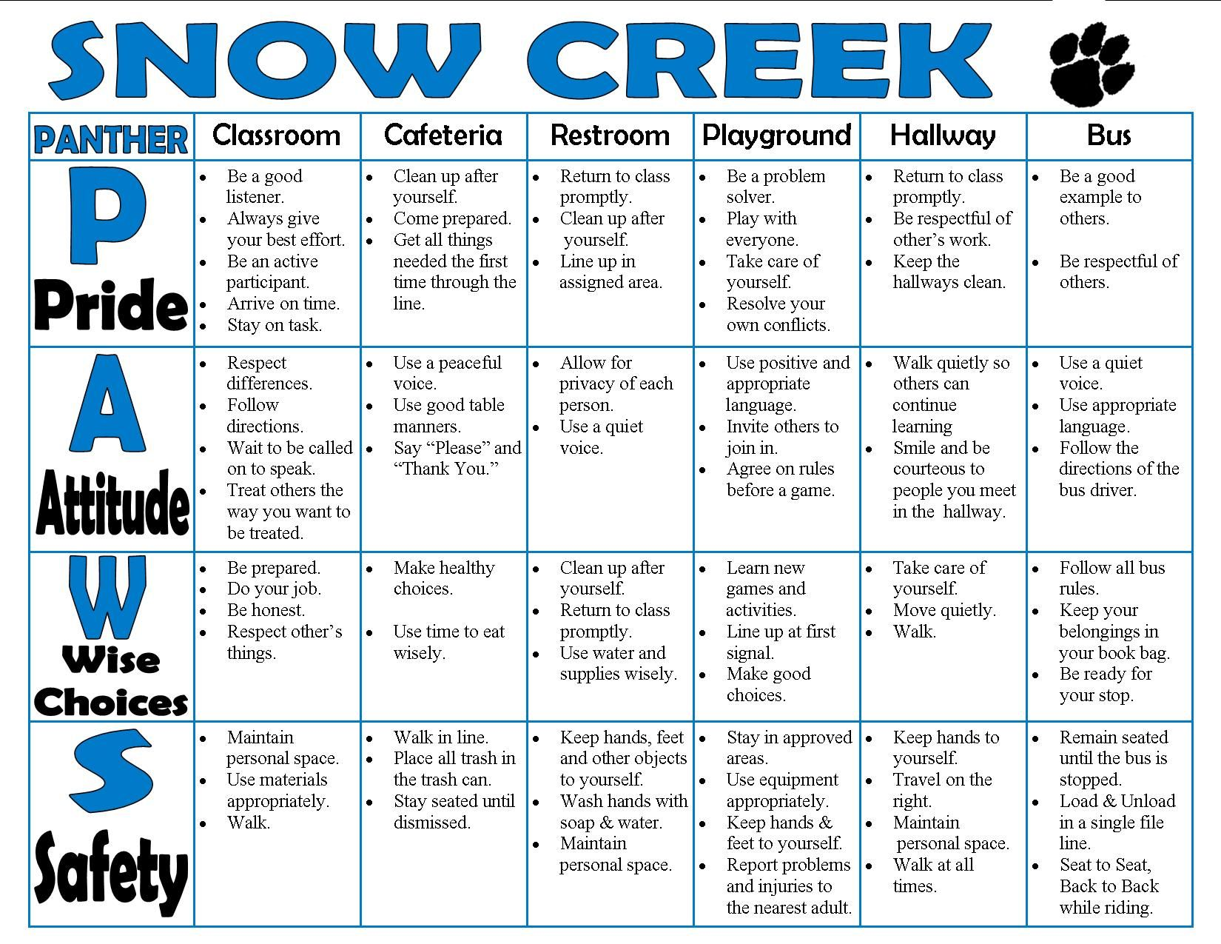
PBIS Teaching Matrix

Slide 32
Explicitly Teach Expectations
All Areas
All Staff and Students

Slide 33
Why teach expectations? What not just tell them the rules?
Cannot assume that students can demonstrate procedures in each setting. Need to teach behaviors in context.
  What does “be safe” look like in the lunchroom?
  What does “be responsible” look like for assemblies?
Teaching allows students to practice appropriate behavior and builds fluency
Allows students to see non-examples of the expectation
Know when consequences will be applied
Decrease student response “I didn’t know….”

Slide 34

A procedure is something to do…
A rule is a dare to be broken.

Slide 35
Tips for Explicit Instruction
Teach in environments where the behavior is required—all non classroom settings
Practice in environments where the behavior is required—all non classroom settings
Ensure consistency between instructors—lesson plans
Plan for booster sessions
Write down the plan for future reference and adjustment

Slide 36
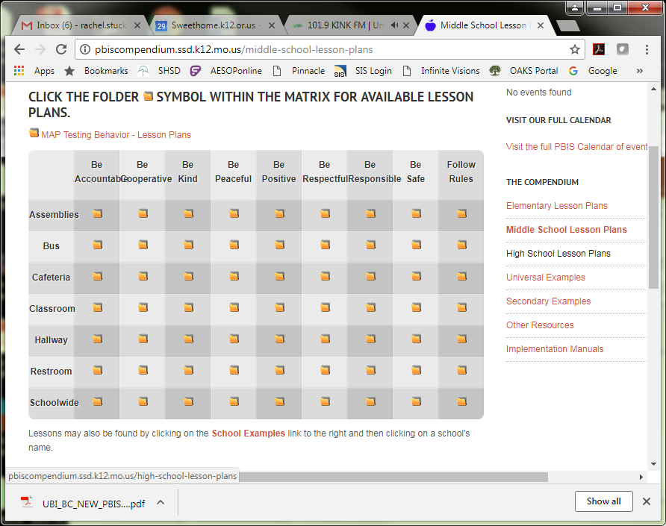
pbiscompendium.ssd.k12.mo.us

Slide 37
Reinforce Expectations
All Areas
All Staff and Students

Slide 38
Components of School-wide Reinforcement
Often Overlooked
  Positive parent contact
  Random reinforcement strategies
  Positive public posting
  Continuous behavioral feedback for students and staff
  Data on positive reinforcement
  Other enhancements

Slide 39
Correct Behavioral Errors
All Areas
All Staff and Students

Slide 40
Trauma Informed Schools
Consider what ‘triggers’ children with higher ACE scores
Train staff
Offer options, or a continuum, for discipline
Communicate options in your handbooks

Slide 41
What can you focus on before September?
Pre-service PBIS components
  School-wide expectations
  Location-Specific Behaviors
  Building Recognition System
  Consequence System
  Implementation Plan

Slide 42

Why Review PBIS Essentials?
We’re looking at our handbooks today.
Handbooks are a direct reflection of the core values of the school and its staff.

Slide 43

Taking a Closer Look……
PBIS Handbooks
High School
Junior High
Elementary

Slide 44
What could a staff handbook include?
PBIS at your school
What is PBIS? Why PBIS?
PBIS Leadership Team—dates, purpose, etc
Responsibilities
  Staff and students
  ‘Universal’ Matrix
Procedures/Policies
School-wide acknowledgement system
Teaching Behavior Expectations
Discipline Procedures
  Flow chart—staff v. office
  Possible classroom interventions
  Referral examples and process
    Blue=Can also go in parent handbook

Slide 45

Handbook Examples of Discipline

Slide 46
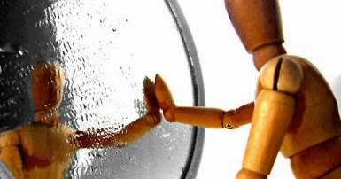
Handbook Work Session
What do you want your staff and parent handbooks to reflect?

